Slide 1
CL 4467 Group Project

Slide 2
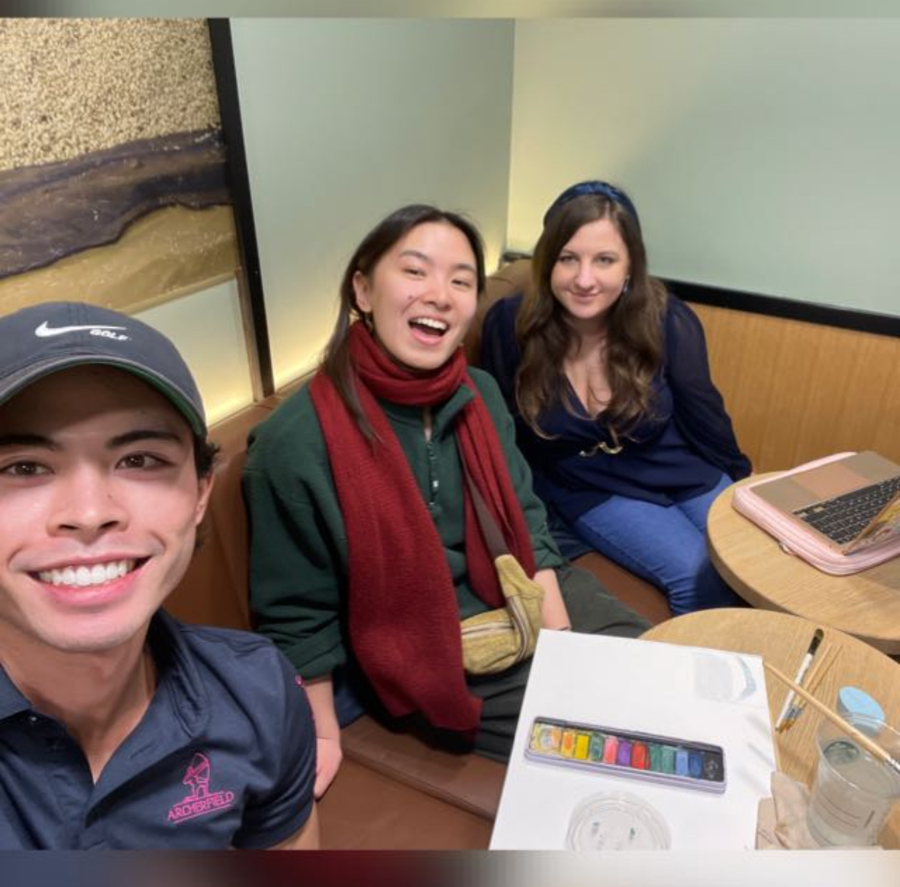
OUR TEAM
Emily Dale
Cole Lum
Eleanor Shorten

Slide 3
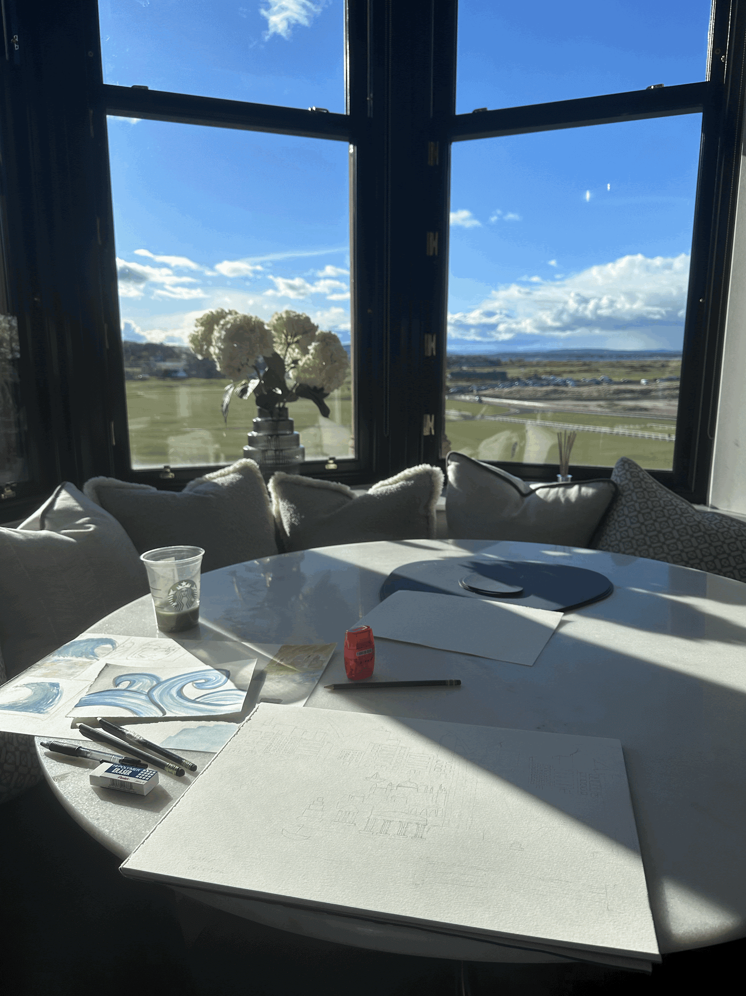
PROJECT OVERVIEW
We aim to draw parallels between the ancient classical myths and modern day environmental issues through the media of storytelling and visual accompaniments and practical workshops for children to learn early on about these problems.

Slide 4
PROJECT GOALS
UN Sustainable Development Goals 13: Take Urgent Action to Combat Climate Change
UN Sustainable Development Goal 15: Protect and Restore the Environment
Educating the youth in an interdisciplinary way, with the use of art, ancient literature, and socio-economic problems.

Slide 5
TARGET AUDIENCE
-Artistic workshops
-Q&A sessions for kids to engage
-Child-friendly adaptations of Classical literature
-Children ages 11-15

Slide 6
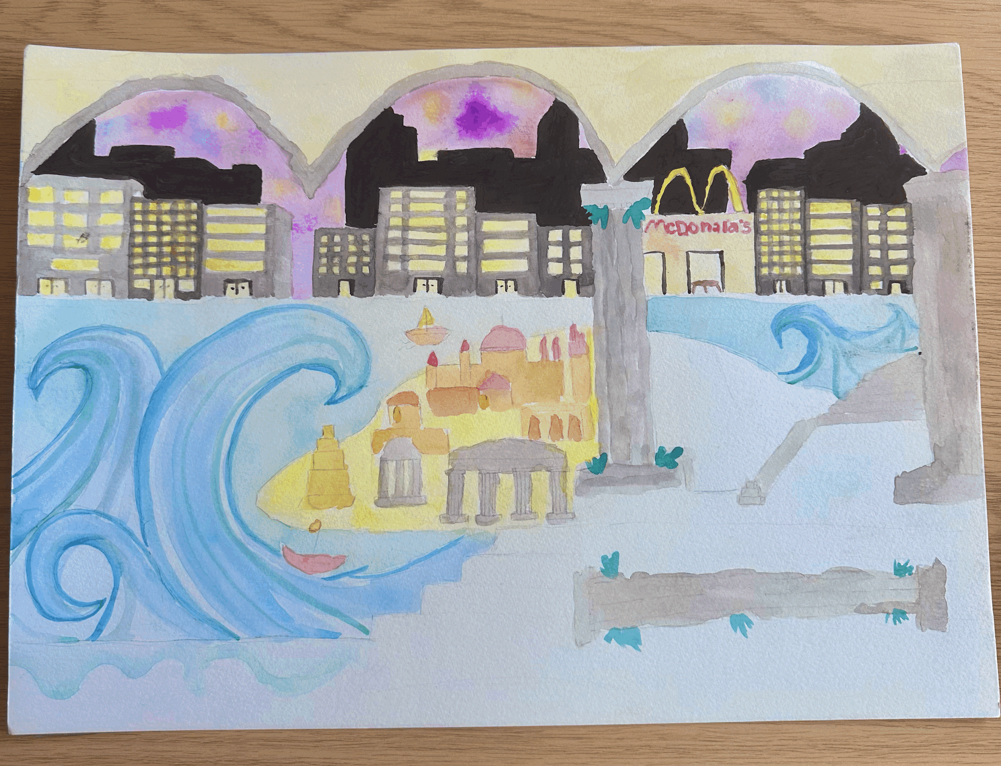
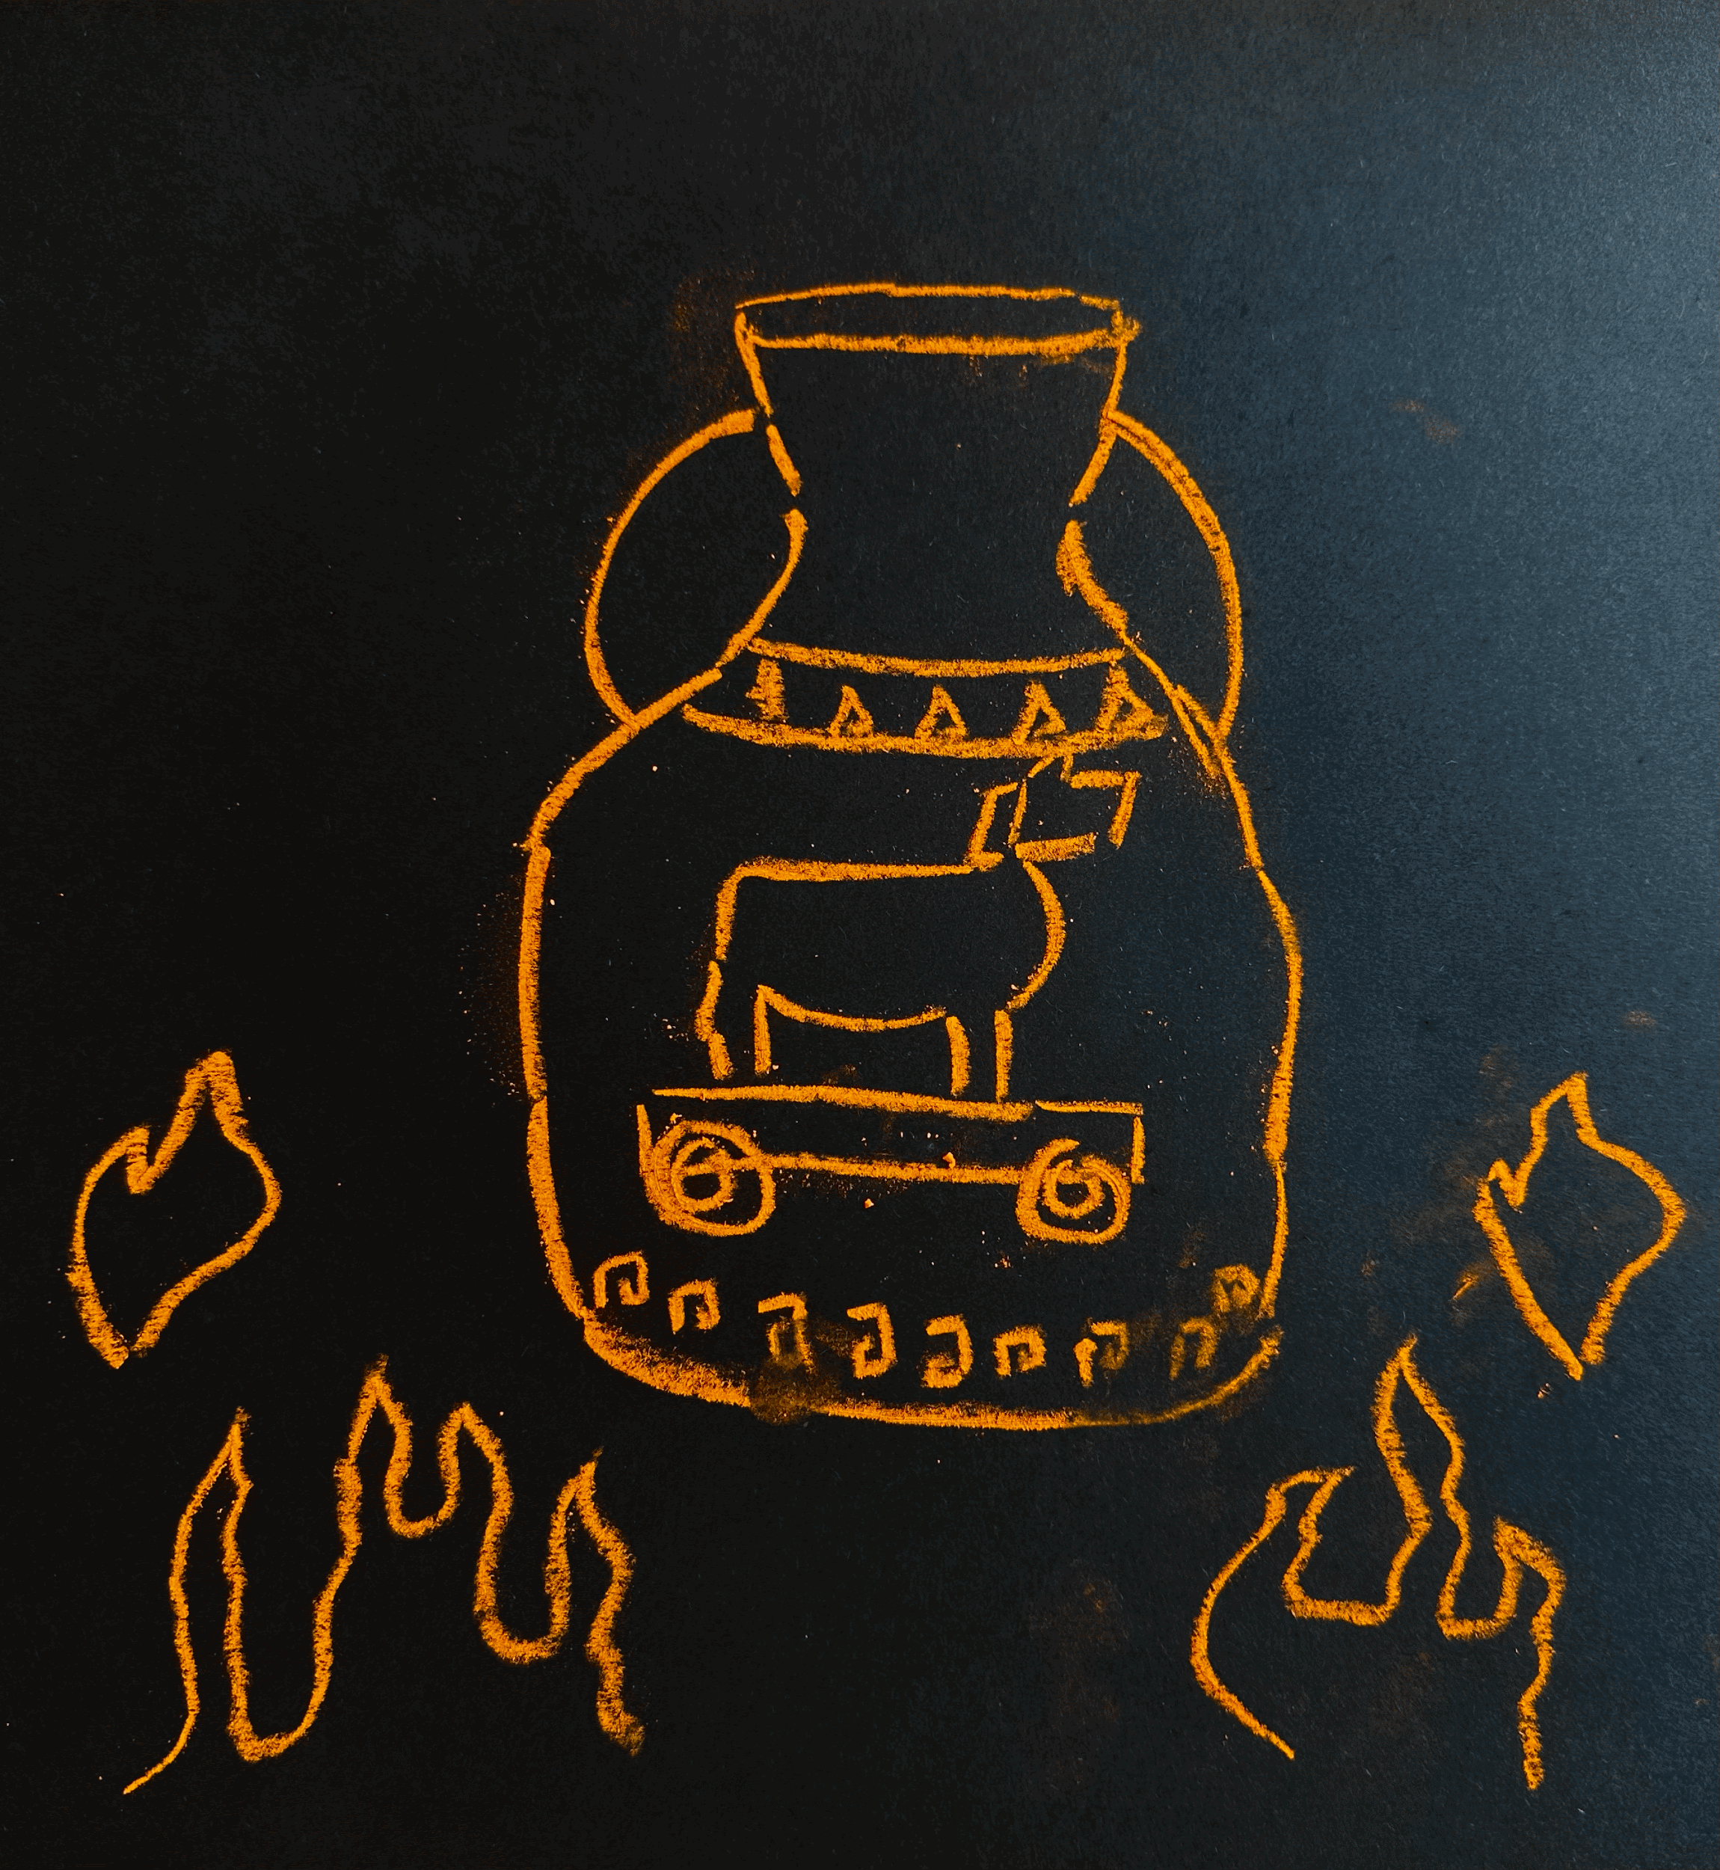
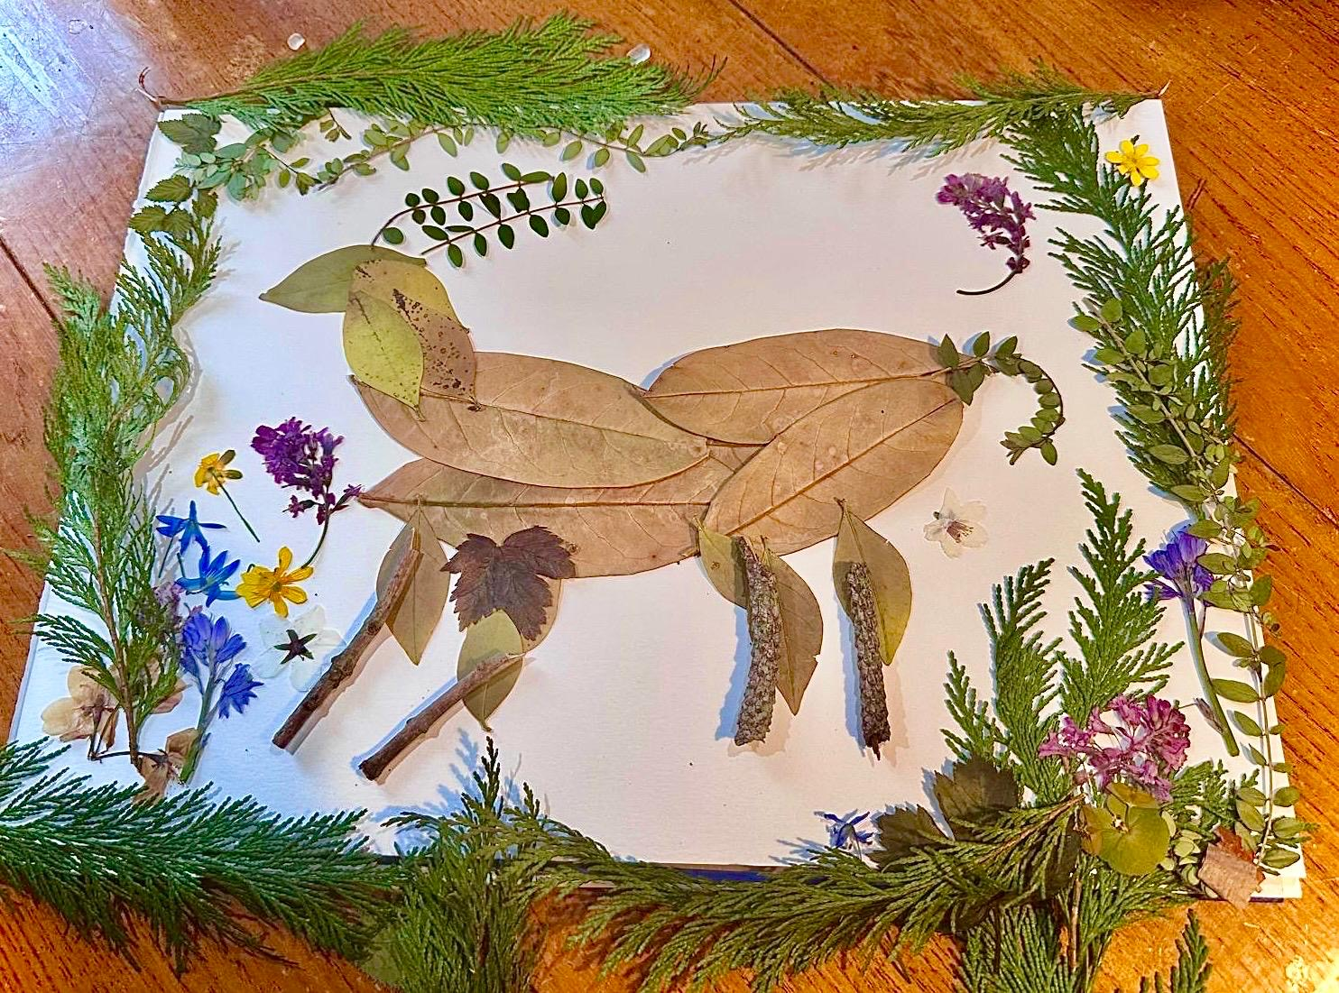
ARTWORK
-Watercolor painting
-Natural Materials Collage
-Pastels/Charcoal

Slide 7
Bibliography
Primary:
Apollonius Rhodius, Argonautica Apollonius Rhodius (tr. Race, 1943)
Aristotle, Metaphysics 985a31–3 (tr. Tredennick, 1933)
Avatar: The Last Airbender (2005-8), Nickelodeon, showrunners M.D. DiMartino, B. Konietzko
D Scholion on Iliad 1.5 (tr. van Thiel, 2014)
Homer, Iliad (tr. Lattimore, 1951)
Hyginus, Fabulae (tr. Grant, 1960)
Plato, Timaeus and Critias, (tr. Waterfield, 1952)
Pseudo-Apollodorus, Bibliotheca (tr. Frazer, 1921)
Quintus Smyrnaeus, Posthomerica (tr. Hopkinson, 2018)
Seneca, Troades (tr. Wilson, 2010)
Virgil, Aeneid (tr. West, 1990)

Slide 8
Secondary:
Crawford, N.C. ‘Pentagon Fuel Use, Climate Change, and the Costs of War’. Watson Institute: International and Public Affairs, Brown University (2019) pp. 1-46.
Davis, A.P., and Özhatay, N., ‘Galanthus trojanus: a new species of Galanthus (Amaryllidaceae) from north-western Turkey’, Botanical Journal of the Lennean Society 137 (2001) pp.409-12.
EBSCO (2025) Atlantis (lost civilization). Available at: https://www.ebsco.com/research-starters/social-sciences-and-humanities/atlantis-lost-civilization (Accessed: 22 April 2025).
Feder, K.L., ‘Frauds, Myths, and Mysteries: Science and Pseudoscience in Archaeology’
Guggenberger, Georg, ‘Humification and mineralization in soils’ in Buscot, F., Varma, A. (eds.), Microorganisms in soils: roles in genesis and Functions Soil biology, vol. 3 (2005) pp. 85–106
Hesk, J., CL4467 Guest Lecture 20/03/2025
Hornsby, D.J, Arvanitakis, J., Moore, R., ‘Why the time is right to create a new generation of ‘citizen scholars’’, The Conversation (10 December 2015)
Leonard, W.E. (1907). ‘The Fragments of Empedocles’, The Monist, 17 (3), pp.451-474.
Morris, I., ‘The Use and Abuse of Homer’, Classical Antiquity (5:1) (1986)
Sluiter, I., ‘Anchoring Innovation: A Classical Research Agenda’, European Review, 25(1) (2017) pp.20–38.
'The 17 Goals', United Nations: Department of Economic and Social Affairs <https://sdgs.un.org/goals>

